Slide 1

Sixth Edition
Chapter 12
The Correlational Research Study

Slide 2
An Introduction to Correlational Research
Goal: To establish that a relationship exists between variables and to describe the nature of the relationship
  Relationships can be described—not explained
  There is no attempt to manipulate, control, or interfere with the variables
  Testing pre-existing relationships!

Slide 3
Correlational vs Experimental Research
Correlational research
  Intended to demonstrate the existence of a relationship between two variables
    Does not determine cause-and-effect relationship
Experimental research
  Demonstrates a cause-and-effect relationship between two variables

Slide 4
The Data and Statistical Analysis for Correlational Studies
Evaluating relationships for numerical scores and ranks
  Scores in each pair are identified as X and Y.
  Data can be presented in a list showing the two scores for each individual.
  Scores can be shown in a scatter plot graph.
    Each individual’s score is shown as a single dot with a horizontal coordinate (X) and a vertical coordinate (Y).

Slide 5
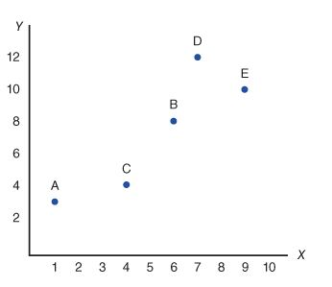
Scatter Plot Data from a Correlational Study
Person | X | Y
A | 1 | 3
B | 6 | 8
C | 4 | 4
D | 7 | 12
E | 9 | 10
Notes:
Figure 12.1 Data from a Correlational Study
Two Scores, X and Y, for each of five people are shown in a table and in a scatter plot.

Slide 6
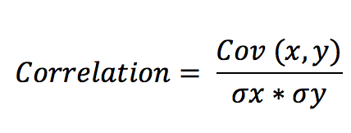
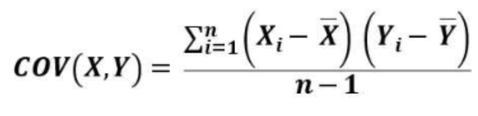
Calculating a Correlation Coefficient (1)
Formula:
Pearson’s r
Covariance
Notes:
Cov on top: Covariance is a statistical measure that indicates the extent to which two random variables change together. In simple terms, it tells you whether an increase in one variable leads to an increase or decrease in another.
Separate measures of variability on bottom

Slide 7
Scatter Plot Data from a Correlational Study
Person | X | Y
A | 1 | 3
B | 6 | 8
C | 4 | 4
D | 7 | 12
E | 9 | 10
Notes:
Figure 12.1 Data from a Correlational Study
Two Scores, X and Y, for each of five people are shown in a table and in a scatter plot.
Sd x = 2.73
Sd y = 3.44
Cov: = 8.24
R = .88
How to interpret?

Slide 8
Interpreting the Strength of a Correlation
Degree of Relationship | Value of the Correlation Coefficient, or Coefficient of Determination
Small | r = 0.10 or r² = 0.01 (1%)
Medium | r = 0.30 or r² = 0.09 (9%)
Large | r = 0.50 or r² = 0.25 (25%)
Notes:
R2: coefficient of determination: is a measure that represents the proportion of the variance in the dependent variable that can be explained by the independent variable(s) in a regression model.

Slide 9
Quantifying Correlations
Correlation Coefficient (Pearson’s r)
Provides an easy interpretation of linear association
Ranges from -1 to +1
  Magnitude AND Direction
Index of consistency
  Do scores change together? If so, how and to what degree?
Notes:
Key features of correlation:
Correlation coefficient aim at offering an easily interpretable index of linear association.
Its value ranges from only from −1 to +1.
Their boundedness makes them easily interpretable than covariances.
Correlation coefficient clearly reflects the direction of the association between two variables (positive and negative association).
Correlation coefficient also reflects the magnitude of association between two variables, unlike covariance.
Its value is based partially on the covariance between the variables.
Correlation coefficient holds a “bounded” quality.
Formula and significance:
Correlation is calculated using the formula: $\text{Correlation}=r_{XY}=\frac{c_{XY}}{S_{X}S_{Y}}$.
Correlation coefficient is important because it plays a vital role in reliability theory, the estimation of reliability, the conceptual basis of validity, the estimation of validity, the effect of response biases on test scores, and the idea of test bias.
Different forms of correlation:
Pearson correlation is the best option for two variables that are on an interval or ratio scale of measurement.
However, there are other forms of correlation too.
For instance, tetrachoric correlation is best for pairs of binary variables. Then there is the Spearman correlation for pairs of ordinal variables.
Index of consistency:
Correlation is a way of evaluating the consistency of individual differences.
Based on the value of the correlation coefficient, the consistency can be positive, negative, or no consistency.

Slide 10
The Significance of a Relationship
Statistical significance of a correlation
  The correlation is unlikely to have been produced by random variation.
    With a small sample, it is possible to obtain what appears to be a very strong correlation when in fact there is no relationship between the two variables.
    Increasing the sample size makes it more likely that a correlation represents a real relationship.

Slide 11
Calculating a Correlation Coefficient (2)
A correlation coefficient measures and describes the relationship between two variables.
  It describes three characteristics of a relationship:
    Direction
    Form
    Consistency or strength

Slide 12
The Direction of the Relationship
Positive relationship: two variables change in the same direction.
  As one variable increases ► the other variable increases.
Negative relationship: two variables change in opposite directions.
  Increases in one variable ► matches with decreases in the other variable
Notes:
Are all relationships linear?

Slide 13
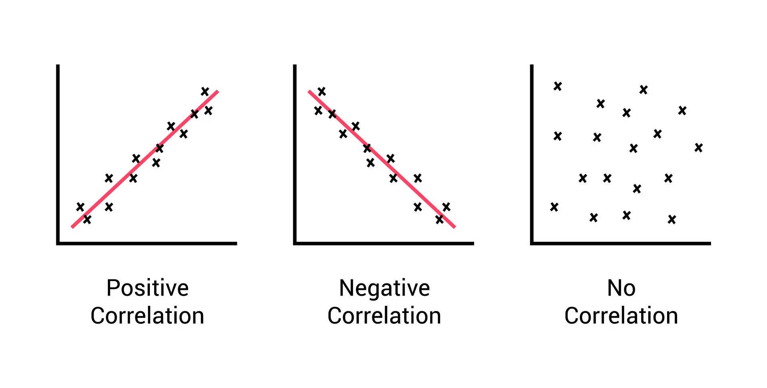
The Direction of the Relationship

Slide 14
The Form of the Relationship
Linear relationship: the data points in the scatter plot tend to cluster around a straight line.
  Positive linear relationship: each time the X variable increases by one point, the Y variable increases in a consistently predictable amount.
    A Pearson correlation describes and measures linear relationships when both variables are numerical scores from interval or ratio scales.

Slide 15
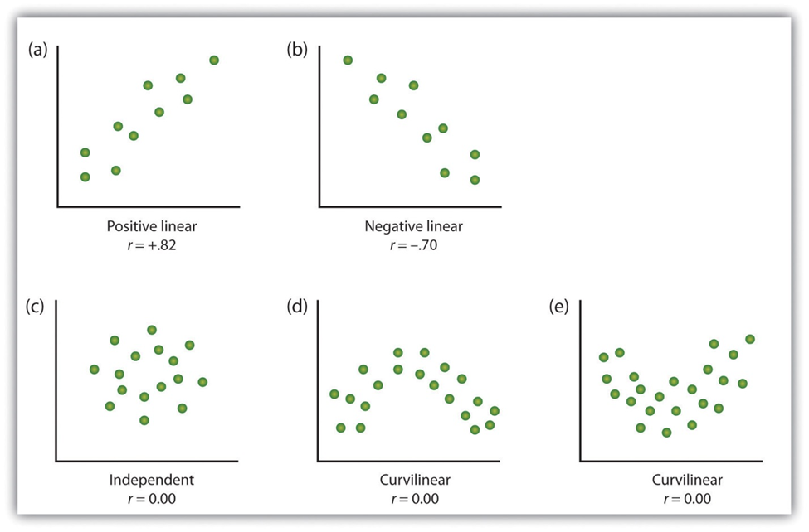
Linear and Non-linear Relationships

Slide 16
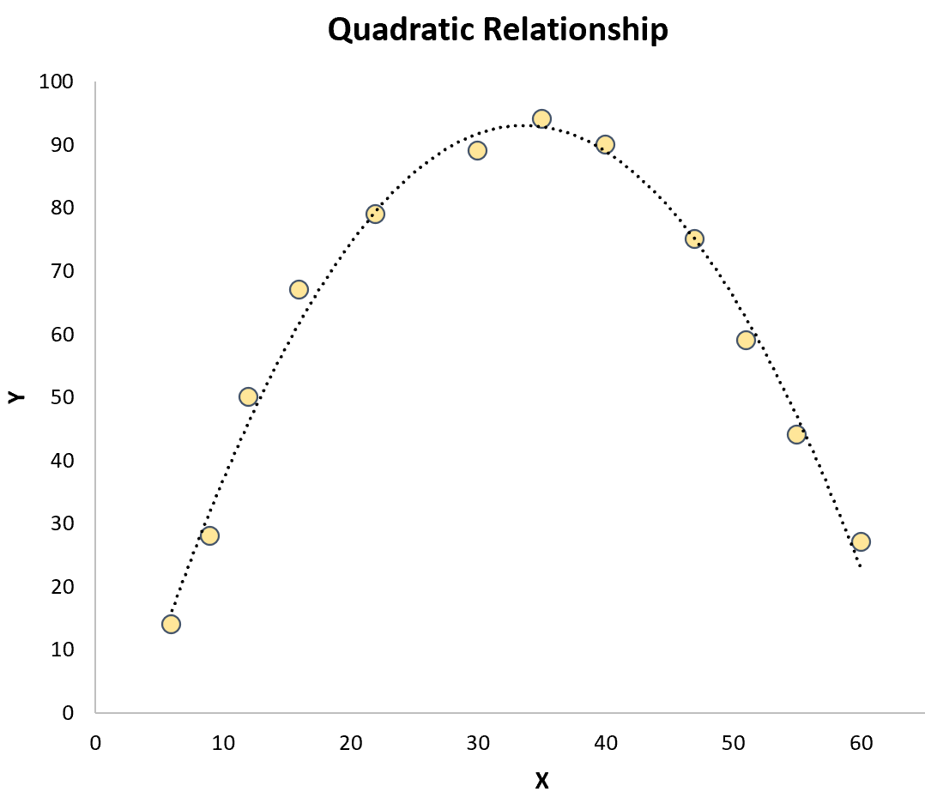
Curvilinear Relationships
Notes:
Examples of curvilinear relationships?
Yerkes-Dodson law
Age and memory

Slide 17
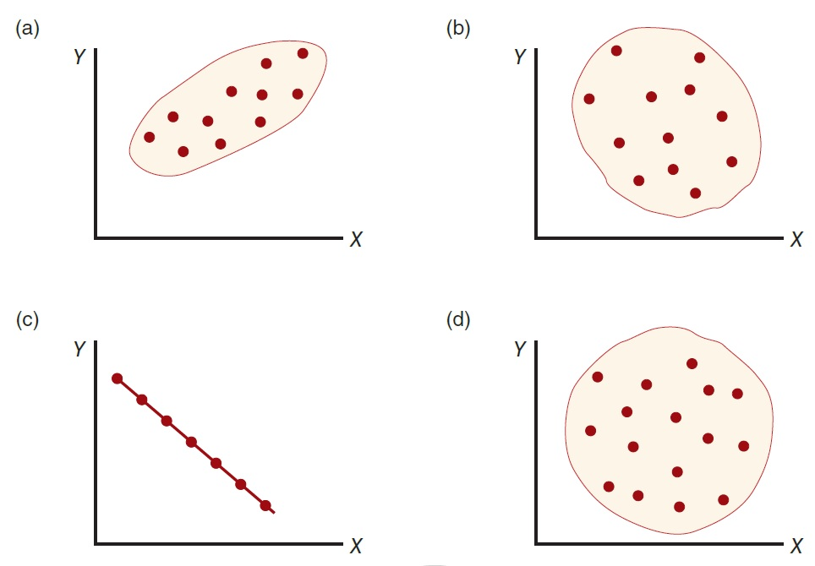
Examples of Different Degrees of Linear Relationship
Notes:
Figure 12.3 Examples of Different Degrees of Linear Relationship
shows a strong positive correlation, approximately 10.90;
shows a relatively weak negative correlation, approximately –0.40;
shows a perfect negative correlation, –1.00;
shows no linear trend, a correlation of 0.
In all graphs, the X values increase from left to right, and the Y values increase from bottom to top.

Slide 18
Applications of the Correlational Strategy
Prediction
  A correlational study demonstrating a relationship between two variables
    Allows researchers to use knowledge about one variable to help predict or explain the second variable
  The two variables
    Predictor variable: the first variable
    Criterion variable: the second variable (being explained or predicted)

Slide 19
Prediction
Regression
  The statistical process for using one variable to predict the other
    Goal: to find the equation that produces the most accurate predictions of Y (the criterion variable) for each value of X (the predictor variable)
      The predictor variable is relatively simple and well defined.
      The criterion variable is relatively complex and unknown.

Slide 20
Linear Regression
Regression Basics:
  Assumption: linear relationship between test scores and criterion scores.
  Formula for straight line: Ĉ = a + b(T). (y = bx + e)
Use SPSS
Predicting?
  Take the test scores (T), plug into the formula, and generate a C score for each individual.
  Does mean C differ between groups?
Notes:
Assumption of regression analysis: There is a linear relationship between test scores and criterion scores.
Formula for straight line:
Ĉ = a + b(T) where:
Ĉ is the predicted training criterion score for an individual training candidate,
a is the intercept,
b is the regression coefficient or slope, and
T is an individual’s aptitude test score.
This formula can be used to predict criterion scores from test scores.
Use of software packages: We can use software packages such as SPSS and SAS to conduct the regression analysis, which produces values of a and b.
Evaluating predictive ability of the test: This is done by taking any individual’s score on the test (T), plugging it into the regression equation, and calculating a predicted score on the criterion (Ĉ) for that individual.

Slide 21
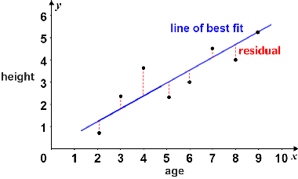
Fit Lines

Slide 22
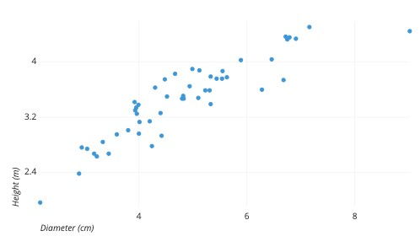
Simple Linear Regression
Formula: y = bx + e

Slide 23
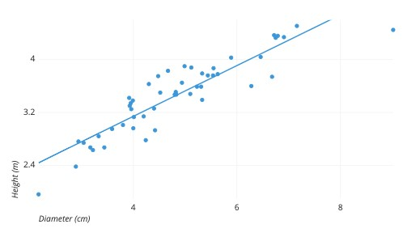
Simple Linear Regression
Formula: y = bx + e
Notes:
Least squares methods

Slide 24
Reliability and Validity and Explaining Theories
Both reliability and validity
  Commonly defined by relationships that are established using the correlational research design
Correlational research design can be used to address many theoretical questions.
  For example, correlational studies of IQs of identical twins

Slide 25
Relationships with More Than Two Variables
Multiple regression: a statistical procedure for studying multivariate relationships
  Can be used to examine the relationship between two specific variables
    Controlling the influence of other, potentially confounding variables
  Predictor variables only predict
  Relationships can be described—not explained

Slide 26
Why use regression?
Predicting outcomes: Which variables are most likely to influence an individual’s scores
  Particularly helpful when multiple variables are being compared
  Are there interactions between variables?
Test for response bias: Do variables/manipulations affect all participants the same way?

Slide 27

Testing for Bias (1)
Intercept Bias
Where does line cross y axis?
Different baselines
Notes:
Figure 11.8: Regression lines for males and females in relation to the common regression line illustrating possible intercept bias.
If a test suffers only from intercept bias, then the size of the group discrepancy is constant across all aptitude scores.
This figure shows that a male trainee of a given aptitude level will obtain a predicted rating that is always 4 points higher than a female who has the same level of aptitude.

Slide 28

Testing for Bias (2)
Slope Bias
Changes occur at different rates
Notes:
Figure 11.9: Regression lines for males and females in relation to the common regression line illustrating possible slope bias.

Slide 29

Testing for Bias (3)
Intercept and Slope Bias
Changes occur at different rates
AND
Groups have different baselines
Notes:
Figure 11.10: Regression lines for males and females in relation to the common regression line illustrating possible slope and intercept bias.
Intercept and slope bias: Occurs when there is a complex relationship between the test scores and the outcome scores for the different groups.

Slide 30
Strengths and Weaknesses of the Correlational Research Strategy
Strengths
  Describes relationships between variables
  Nonintrusive—natural behaviors
  High external validity
Weaknesses
  Cannot assess causality
  Third-variable problem
  Directionality problem
  Low internal validity

Slide 31
Other Weaknesses of the Correlational Research Strategy
The third-variable problem
  Because two variables are related, does not mean that there must be a direct relationship between the two variables.
    A third (unidentified) variable may be responsible for producing the observed relation.
The directionality problem
  A correlational study does not establish a relationship of cause-and-effect.

